Slide 1

Phonetic implementation of phonologically different high tone plateaus in Luganda
Cerys Hughes, Seung Suk Lee, Alessa Farinella and Kristine M. Yu
University of Massachusetts Amherst
ICPhS 2023
August 7 2023

Slide 2





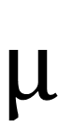



Luganda high tone spans
LH
[òmùlàːŋɡìɾàːmáɲóːmúlálwòːnò]
HH
[òmùlèːnzìjàlúmánːáwólòvù]
$$μ$$
$$μ$$
$$μ$$
$$μ$$
$$μ$$
$$μ$$
$$μ$$
$$μ$$
$$μ$$
$$μ$$
$$μ$$
$$μ$$
$$μ$$
Neutralization
H
H
H
H
H
Notes:
The tone spans we focus on are called LH and HH. Here’s an example of LH [] and here’s an example of HH []. There is only one underlying high tone for the LH span, but two for the HH span. However, through high tone anticipation and high tone plateauing, they both consist of a span of high tones on the surface, resulting in neutralization.
[unclear??]
Maybe talk here about sag and interpolation vs spreading?

Slide 3
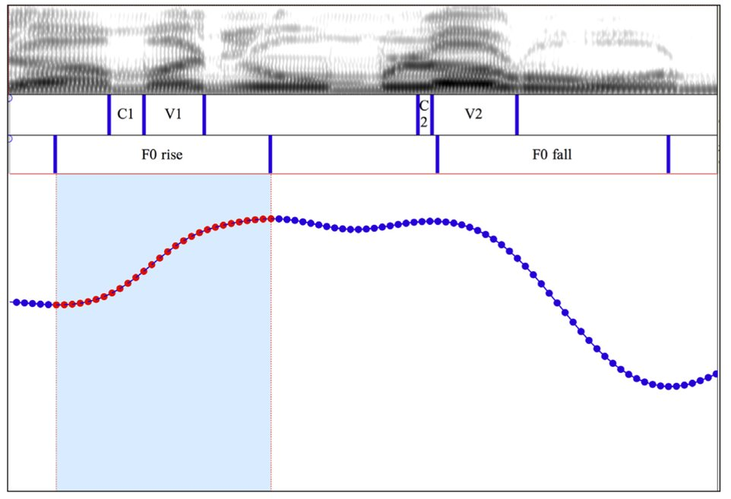
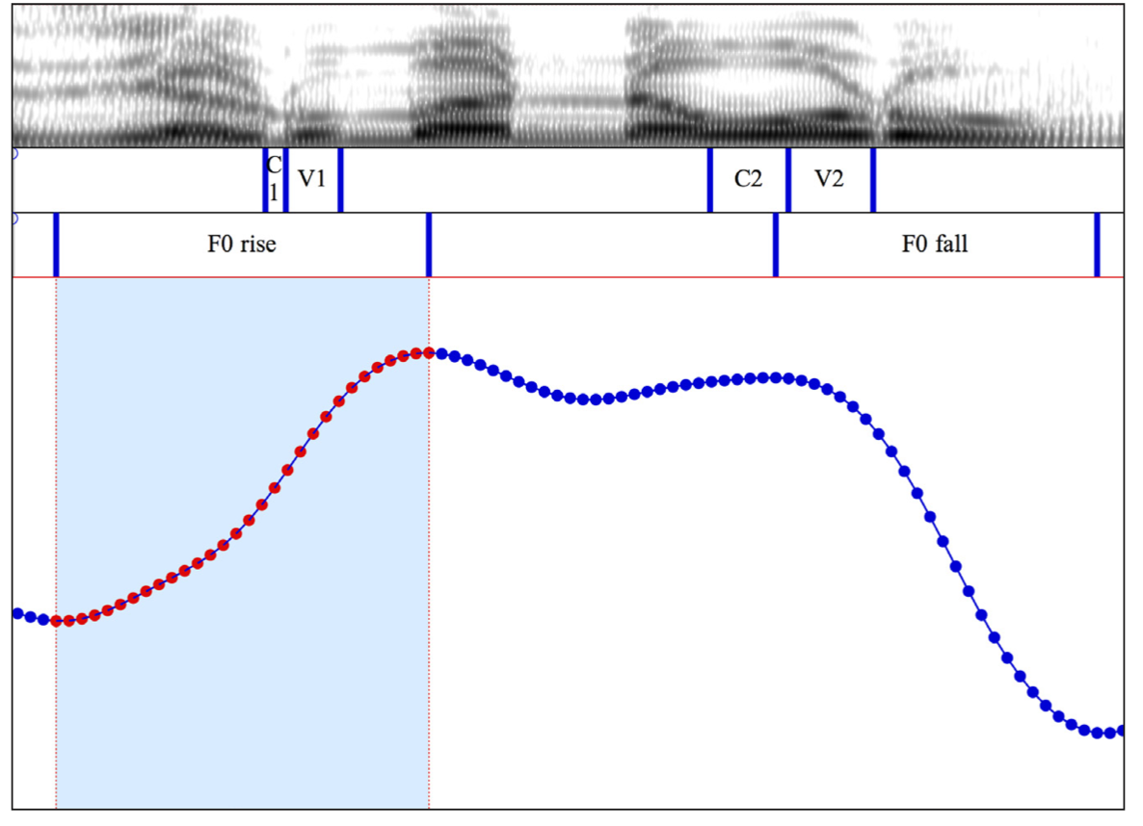
Luganda high tone spans
Do we see a difference in the plateau shape?
LH
Data from Myers et al. 2018
HH
H plateau
H plateau
H
H
H
Less sag
Sag
[òmùlàːŋɡìɾàːmáɲóːmúlálwòːnò]
“The prince recognizes this mad person.”
[òmùlèːnzìjàlúmánːáwólòvù]
“The boy bit the chameleon.”
Notes:
In this presentation we're looking at different types of HTS in Luganda with different UR but the same SR. Left hand- 2 H tones underlyingly. Right- 1 H on the last syllable in the span
I'll play them both. The first is the case of 2 underlying Hs. The second is a case with just one H. You can see that they look quite different. The one on the left has sag while the on e on the right appears to have less sag

Slide 4
Incomplete Neutralization for LH, HH Tones?
Question: Do LH and HH spans have different degrees of sag in their phonetic implementations?
Pierrehumbert 1980 – sag is a function of distance between 2 (intonational) tonal targets
Little work on whether there's similar phonetic implementation in lexical/grammatical tonal spreading processes
Different underlying specification, good test case for tonal incomplete neutralization
A lot of work on incomplete neutralization with segments, not so much on tone (Nicenboim et al. 2018)

Slide 5
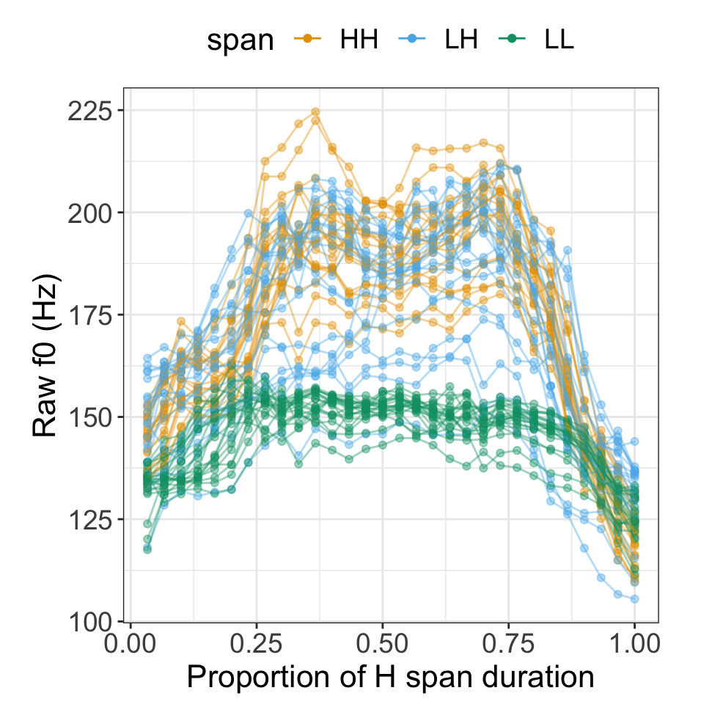
Data
Dataset of 4 Luganda tone spans from Myers et al. 2018
793 tokens, 10 speakers
~20 sentences per span type
Differences in phonetic implementation found in previous work (Myers et al. 2018, Lee et al. 2021, Hughes et al. 2022)

Slide 6
Incomplete Neutralization Methodology
Recent trends to move beyond point-wise measures to take the entire contour into consideration
Methodological innovations: trajectory shape representations
Vowel formant contours (Stanley et al. 2021, Hualde et al. 2021)
Liquid formant contours (Simonet et al. 2008)
F0 contours (Chen et al. 2013, Gubian et al. 2015, et seq)
Researcher choices relevant to answering LH vs HH question:
Types of normalization
Methodological innovations:
Functional Principal Component Analysis (FPCA)
Generalized Additive Mixed-effects Model (GAMM)

Slide 7
Overview of the current study
Using contour shapes in addition to point measurements can reveal further phonetic implementation differences
Normalization technique is not just a preprocessing step: different choices can affect analyses of contour shapes
Within-speaker vs. Within-token
Mean centering vs. Z-scoring
Different methods of analysis found different shape differences between LH and HH
FPCA or GAMM

Slide 8
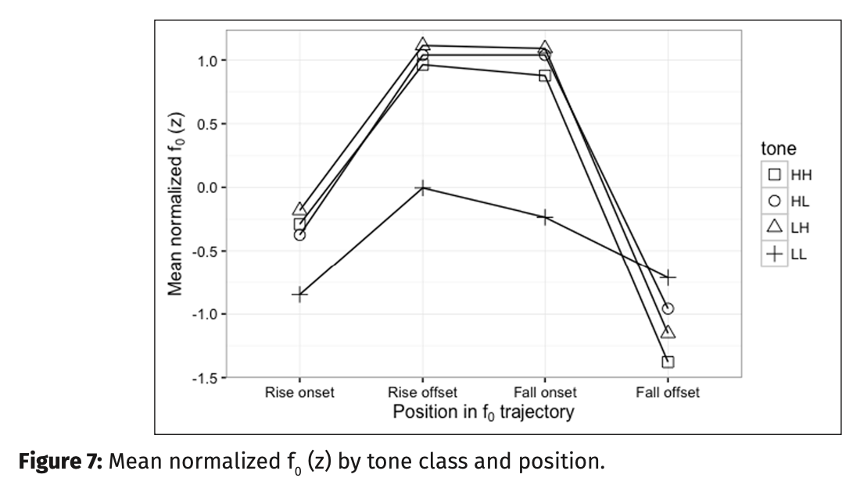
Previously found implementation difference
Data from Myers et al. 2018
Found difference in f0 rise and fall for some Luganda high tone spans (LL, HL, LH, HH) (Figure 7 from Myers et al. 2018)
?

Slide 9
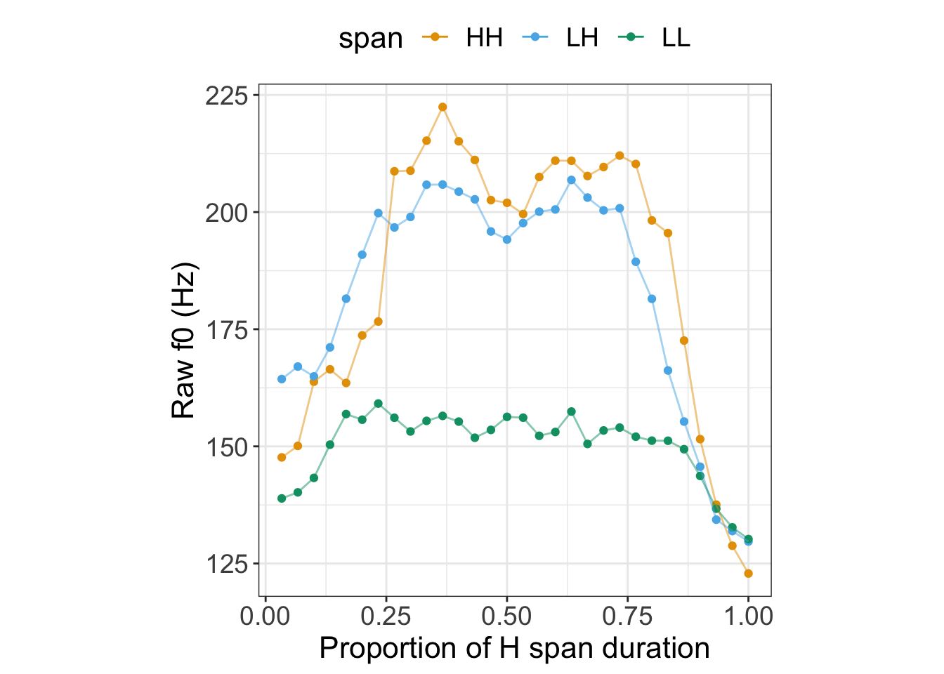
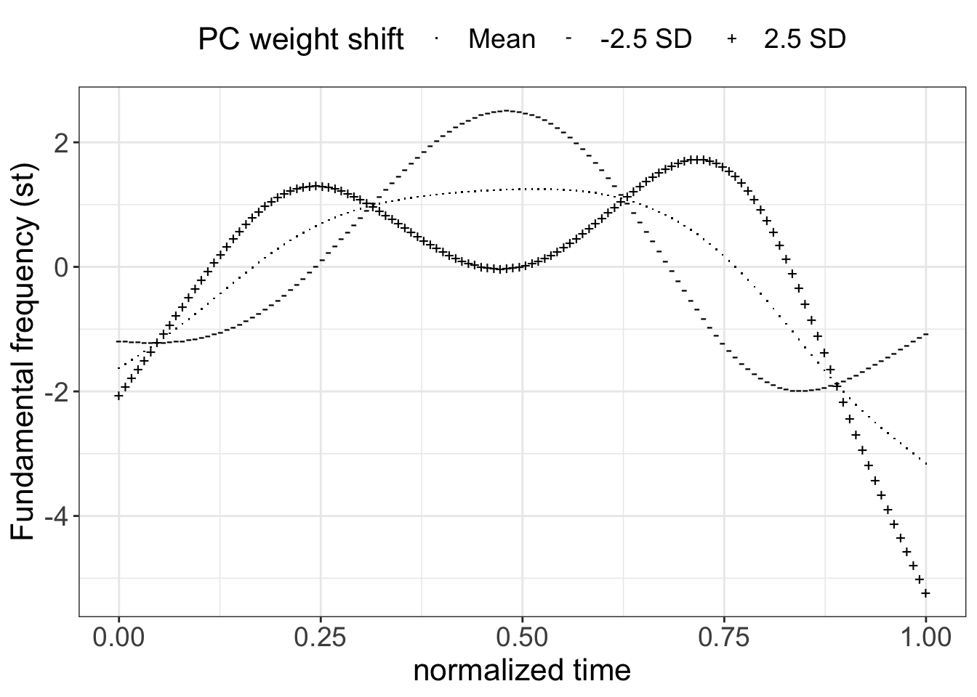
Previously found trajectory shape difference
Lee et al. 2021, Hughes et al. 2022 found a difference between LH and HH in their trajectory shape using Functional Principal Component Analysis

Slide 10
Researcher choices in previous findings
Normalization of F0 contours
By-speaker z-scoring in Myers et al. 2018
Within-token mean centering in Lee et al. 2021, Hughes et al. 2022
Different methods of analyzing trajectory shapes
FPCA in Lee et al. 2021, Hughes et al. 2022
GAMM?

Slide 11
Normalization Techniques

Slide 12
F0 Data-preprocessing approaches
F0 vs Log-transformed F0 (e.g. semitones)
(Zhang 2018 a.o.)
Mean centering vs scaling (z-scoring)
(Cheng et al. 2015, Gubian et al. 2015 a.o.), cf. (Myers et al. 2018, Lohfink et al. 2019, Gryllia et al. 2022 a.o.)
Within-token vs within-speaker
(Cheng et al. 2015, Gubian et al. 2015 a.o.), cf. (Myers et al. 2018 a.o.)
Current study:
Within-token mean-centering, within-speaker z-scoring, and within-speaker mean-centering

Slide 13
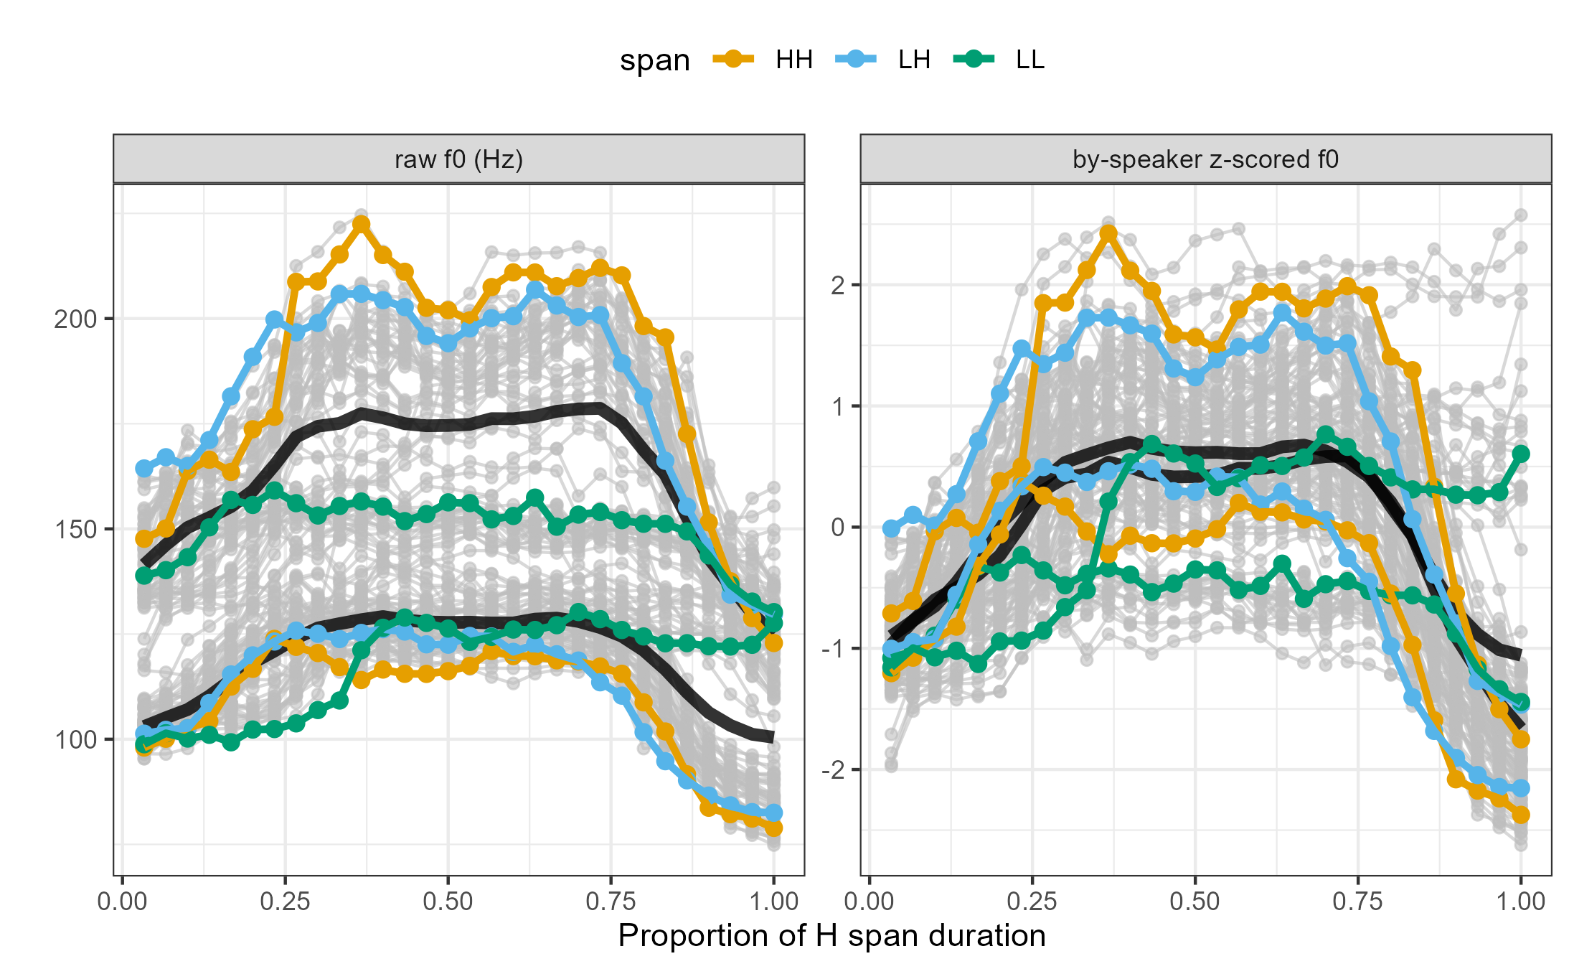
Within-Speaker z-scoring
Speaker X
Speaker Y

Slide 14
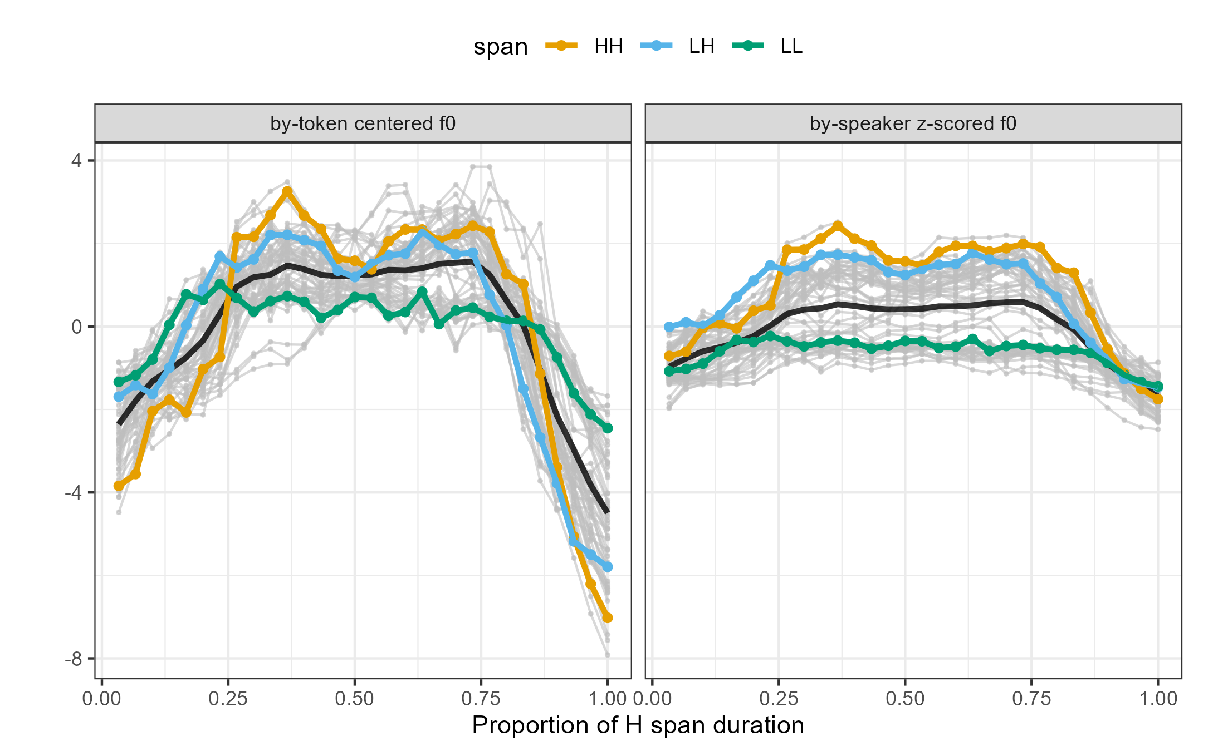
Within-Token Centering
"Sag" defined
in terms of token's F0 range (Pierrehumbert 1981)

Slide 15
Analysis Method Choices
FPCA or GAMM

Slide 16
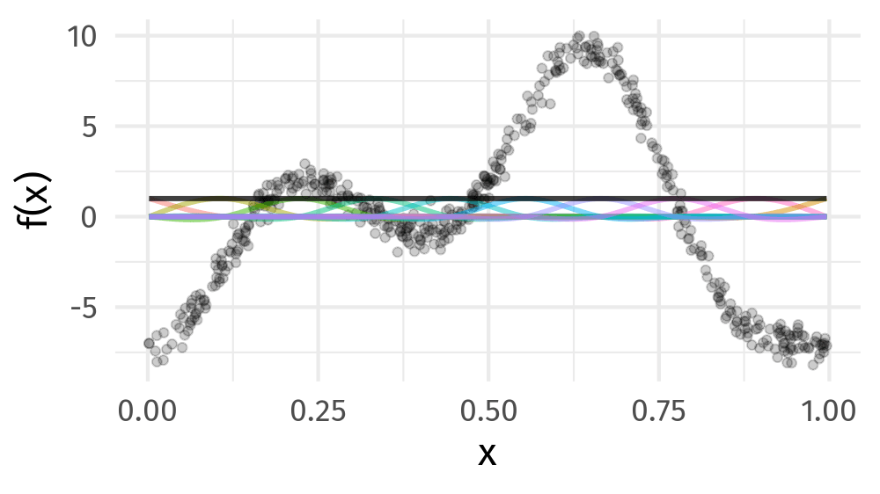
Representing Function Shapes
https://github.com/gavinsimpson/intro-gam-webinar-2020

Slide 17
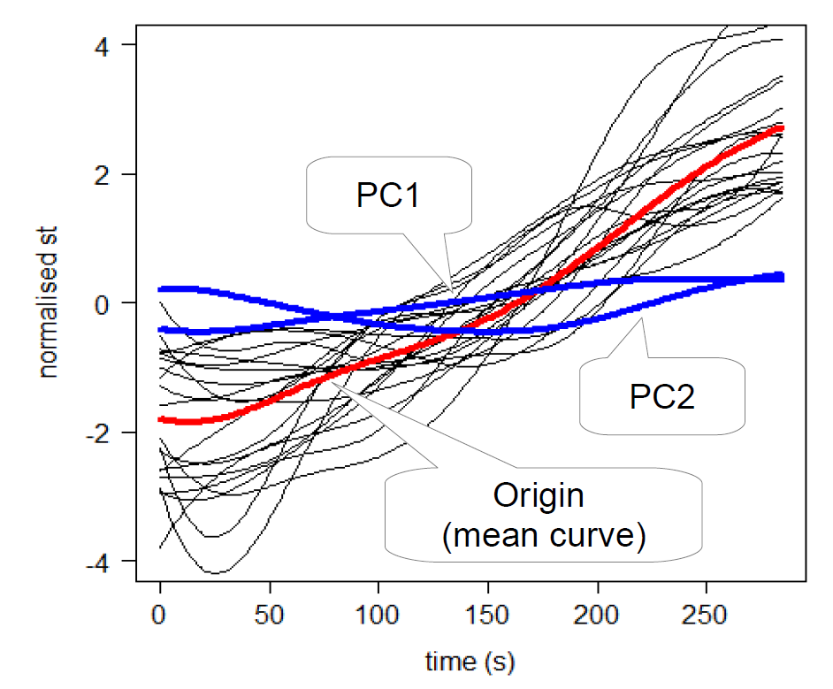
Functional Principal Components Analysis (FPCA)
Represent F0 contours with function shape weight
Identify function shapes that F0 contours maximally vary on
Principal Component Functions (PCs)
Weighted sum of PCs
Gubian (2020)

Slide 18
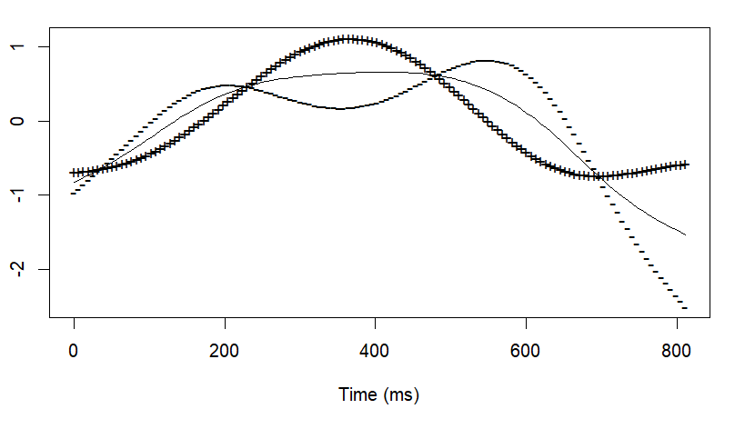
One of PCs: Sag shape
More negative sag PC weight = more sag in an f0 contour
Mixed effects linear regression model:
Predict sag PC weight from span type (LH or HH)
By-speaker random intercepts
Does span type (LH vs HH) have a significant effect on sag PC weight?
Lee et al. 2021, Hughes et al. 2022: difference in sag PC between LH, HH
Present work: Replication (+ duration interaction) with small differences from normalization choice

Slide 19
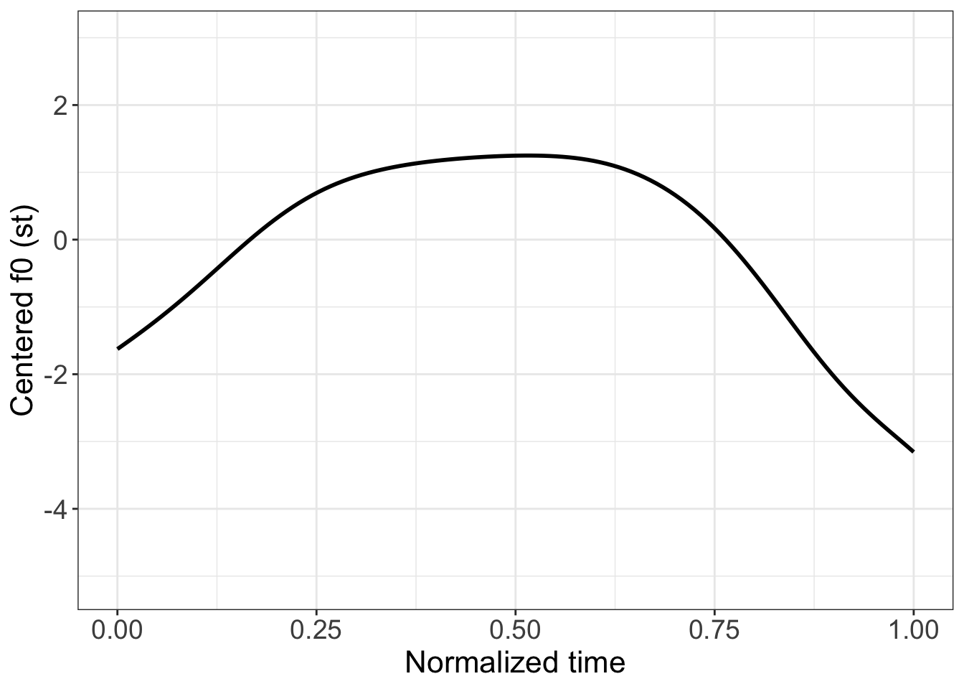
More negative sag PC weight = more sag in f0 contour

Slide 20
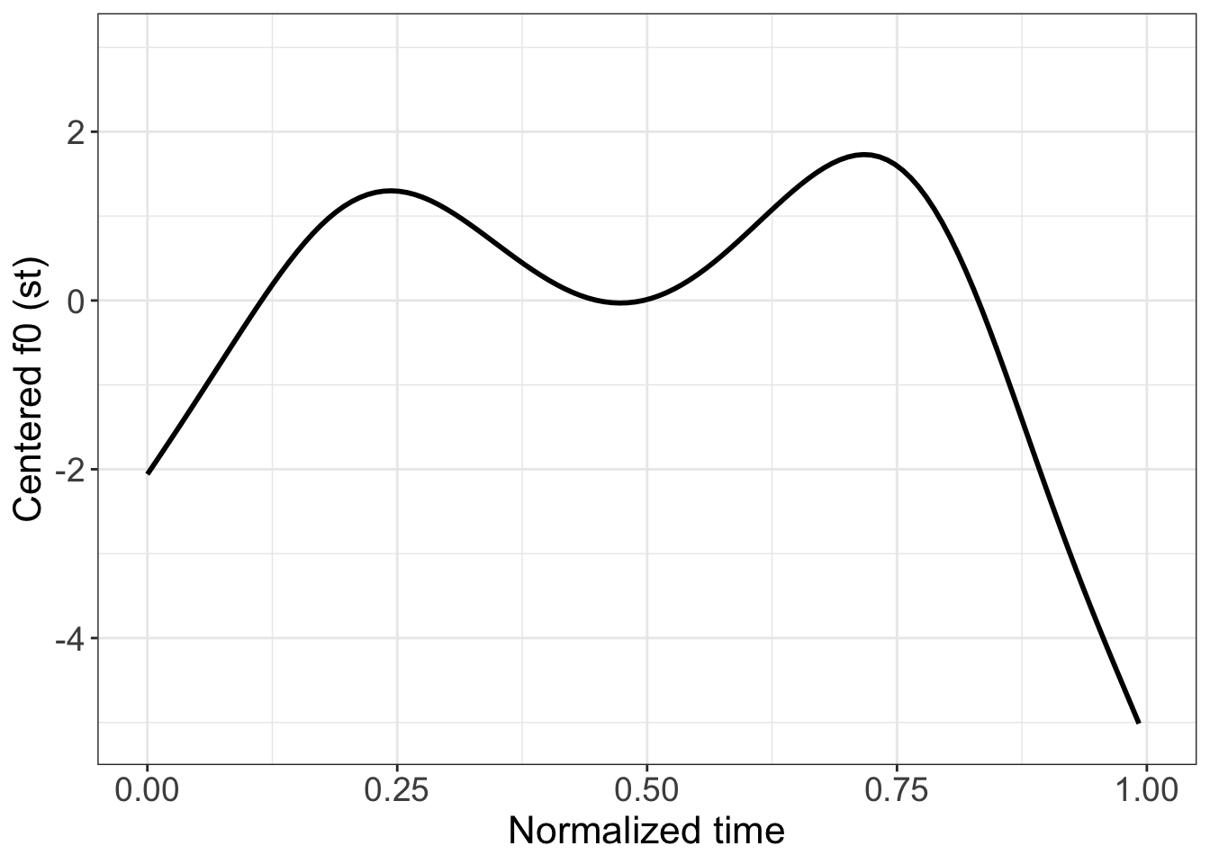
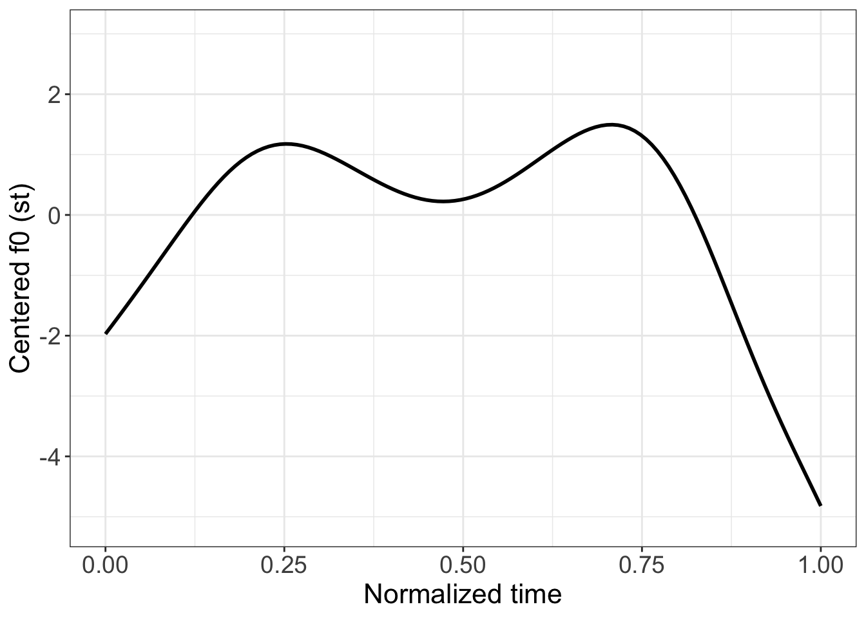
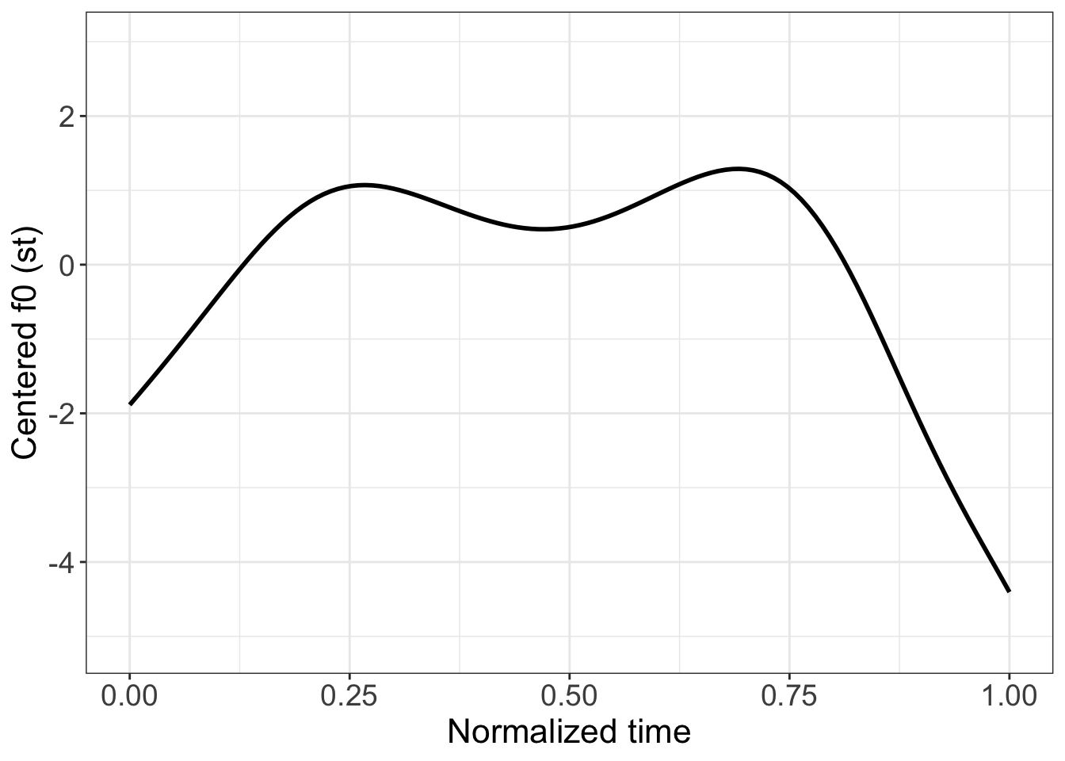

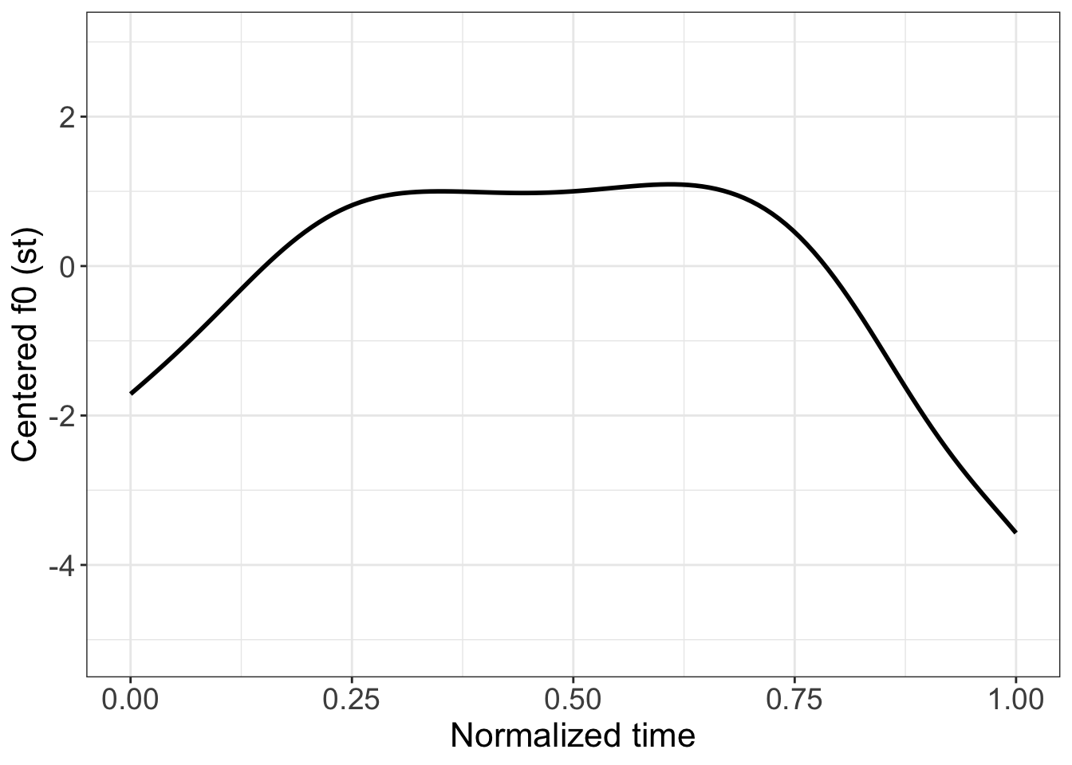
More negative sag PC weight = more sag in f0 contour
Sag PC weight more neg.

Slide 21
More negative sag PC weight = more sag in f0 contour
Sag PC weight more and more neg.

Slide 22
More negative sag PC weight = more sag in f0 contour
Sag PC weight more and more and more neg.

Slide 23
More negative sag PC weight = more sag in f0 contour
Sag PC weight more and more and more and more neg.

Slide 24
More negative sag PC weight = more sag in f0 contour
Sag PC weight more and more and more and more and more neg.

Slide 25
F0 normalized by speaker z-score
Span type affects predicted sag PC score
Duration interaction: Magnitude of difference is smaller for longer durations

Slide 26
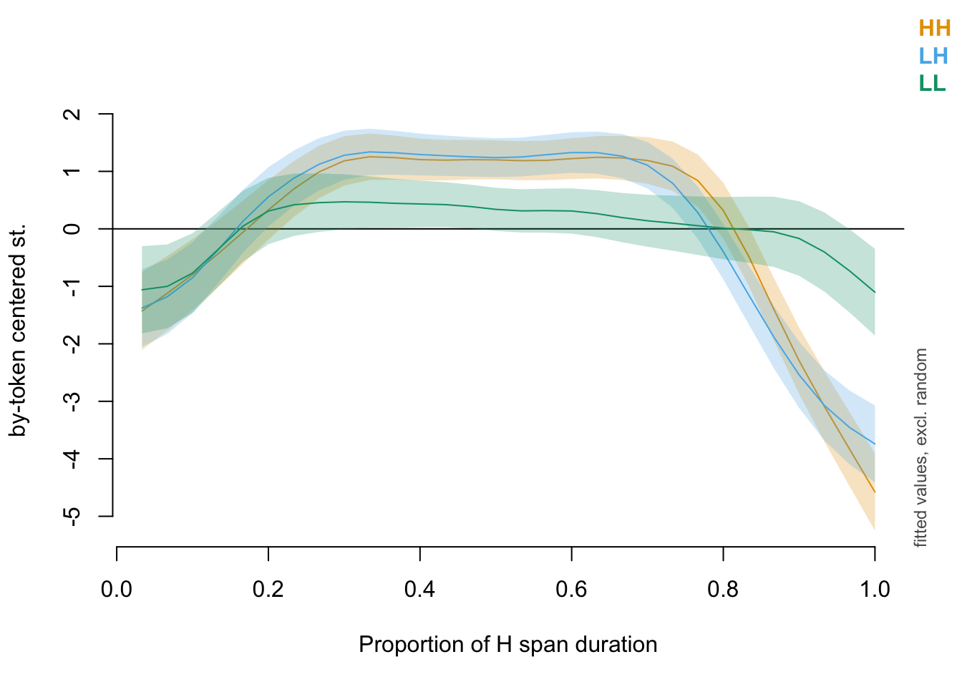
Generalized Additive Mixed-Effects Model
Fit F0 contour over time
Model corrections for correlation between timepoints
Unlike FPCA
only produces overall curve, not components like sag
No evidence for sag difference between HH, LH curves

Slide 27
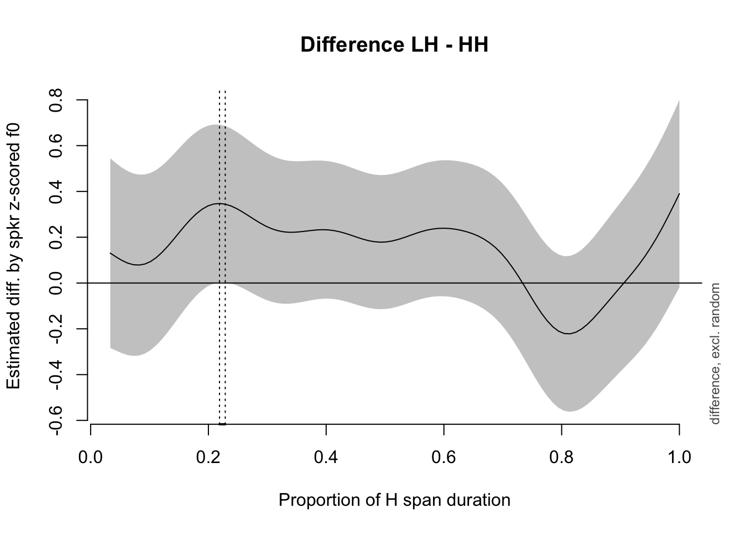
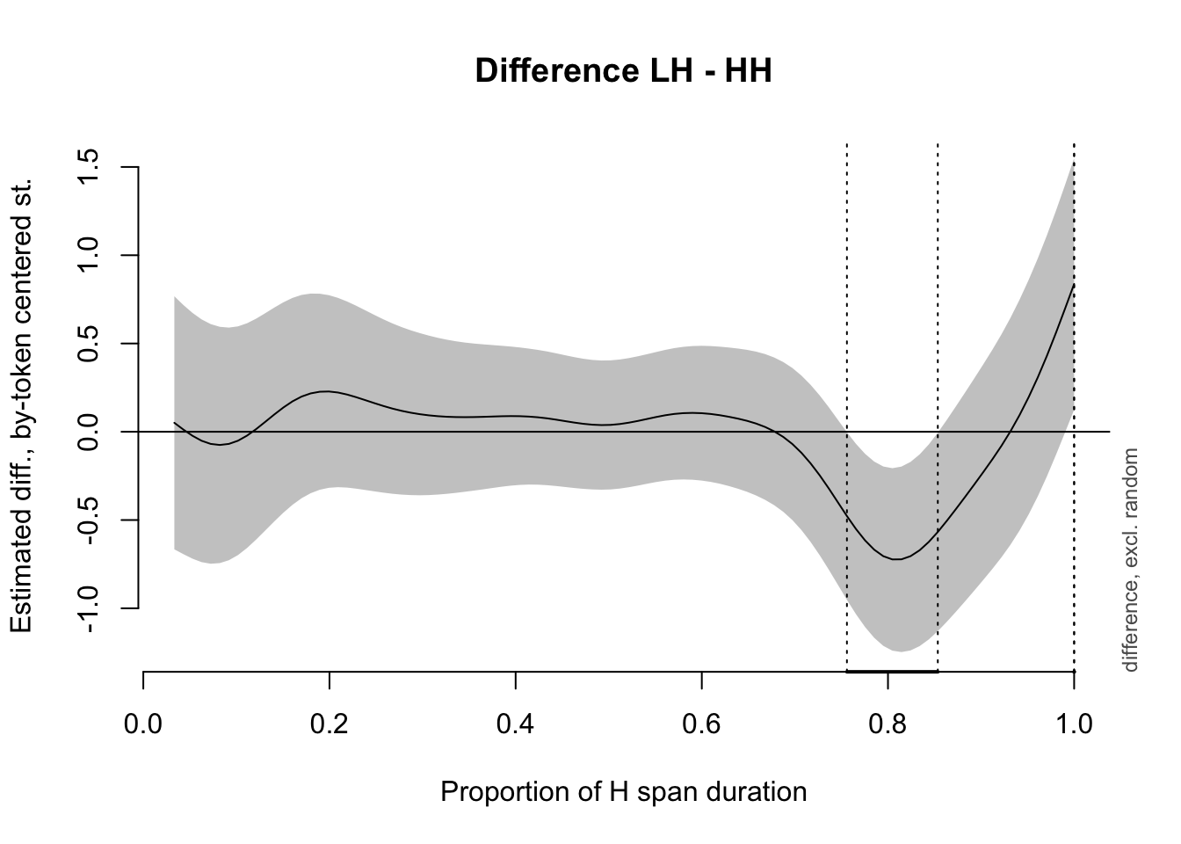
Generalized Additive Mixed-Effects Model
Differences besides sag found depending on F0 normalization choice
By-speaker normalization:
Rise difference
By-token centering:
Fall difference

Slide 28
Discussion and Conclusion
Understudied: understanding implementation of transition between tonal targets and tonal incomplete neutralization
Normalization and model choice affect findings
Replication of LH, HH sag difference with FPCA
No apparent LH, HH sag difference with GAMMs
Less control over which component to test: interpretability
Small amount of data available
Need more work to support one choice over another, e.g. theoretical or perceptual results

Slide 29
Appendix

Slide 30
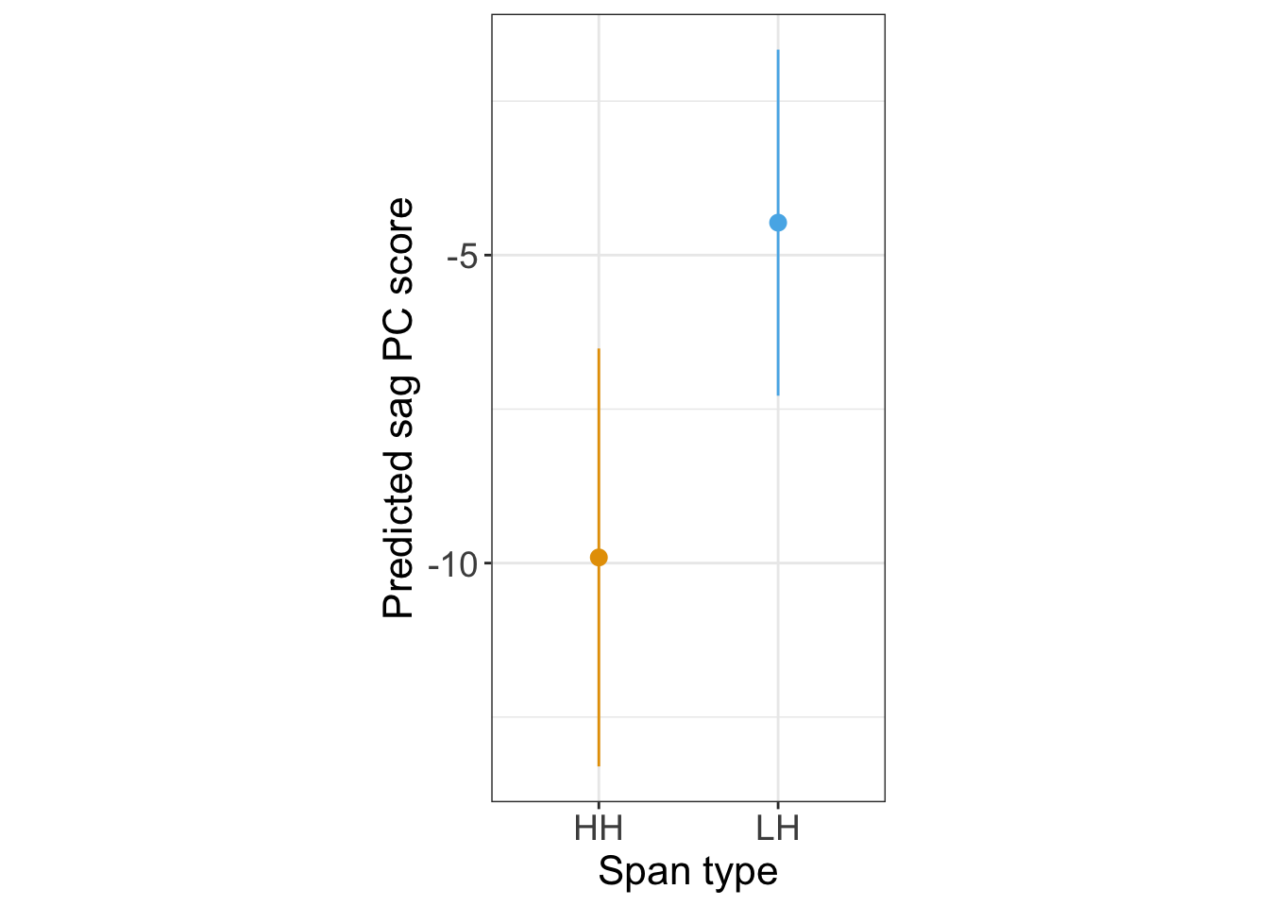
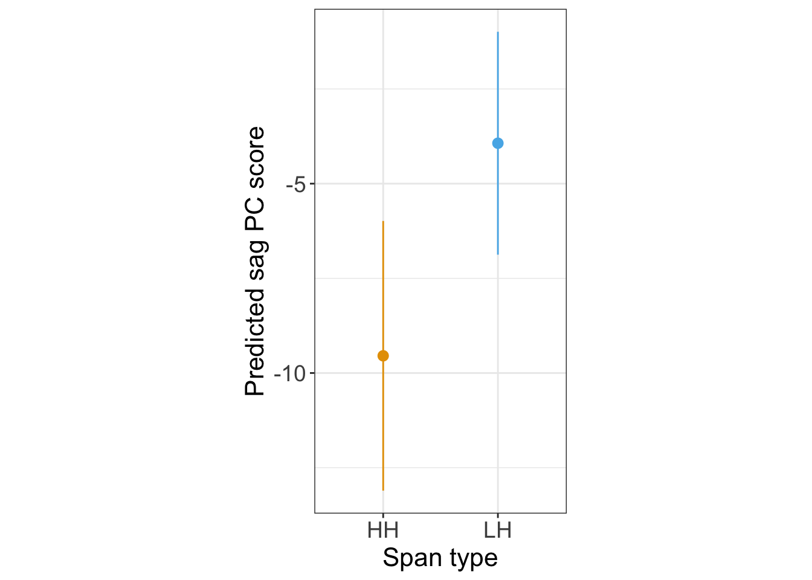
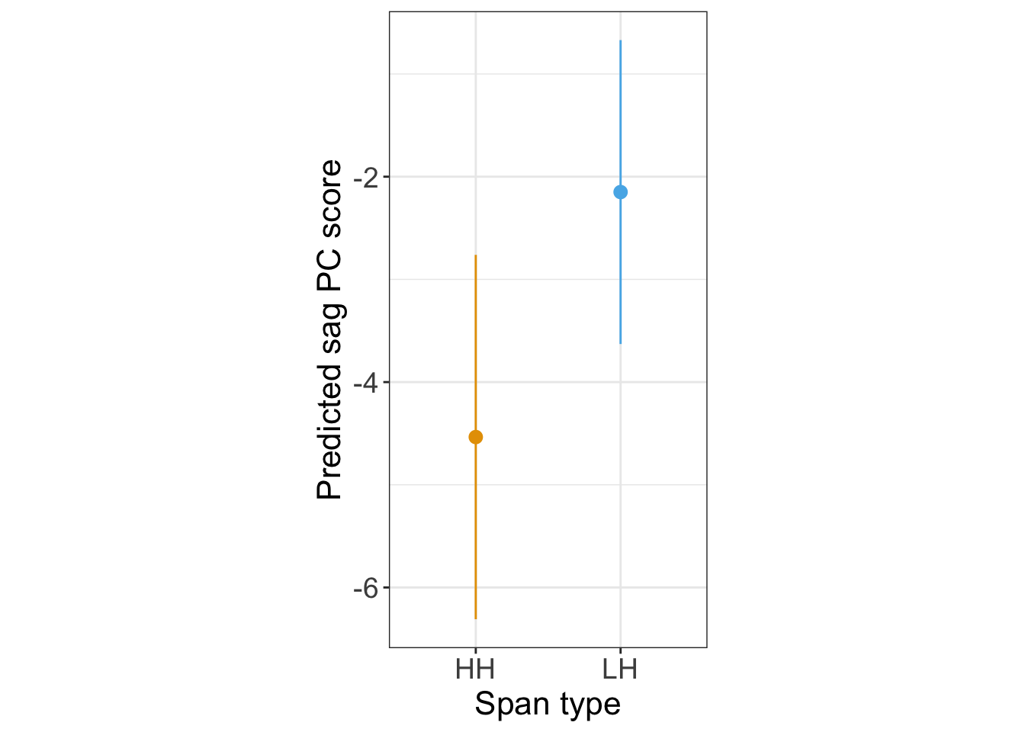
FPCA: HH significantly saggier than LH for all normalizations
By-token centered (st)
By-speaker centered (st)
By-speaker z-score (Hz)

Slide 31
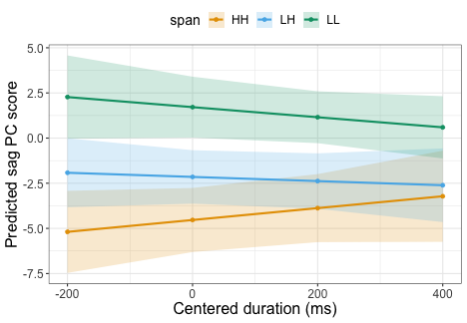
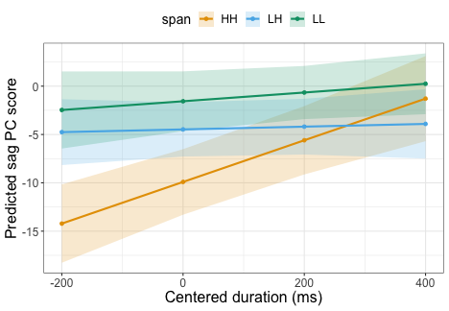
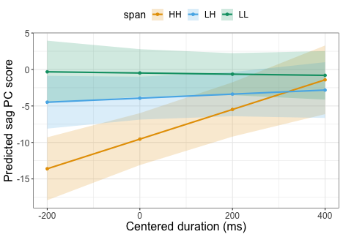
FPCA: Difference in sag between HH and other span types decreases with longer durations (all normalizations)
By-token centered (st)
By-speaker z-score (Hz): duration interaction not significant for HH vs. LH
By-speaker centered (st)

Slide 32
FPCA model specification: sag PC component weight as dependent variable
pc.sag.weight ~ span * duration
+ (1|speaker)
+ (1|item)

Slide 33
GAMM specification: with autoregressive AR1 structure to take time series dependence in residuals into account
# estimate correlation from model
ar1.rho <- start_value_rho(gam.no.ar1)
bam(z.F0 ~ span + duration +
s(prop.span.dur, by=span, bs="tp",k=15)+
s(prop.span.dur,speaker,bs="fs",m=1,k=15)+
s(prop.span.dur,item,bs="fs",m=1,k=15) +
s(prop.span.dur,speaker, by=span.ord,bs="fs",m=1,k=15),
rho=ar1.rho, AR.start = start.event,
discrete = TRUE, family = "scat")

Slide 34
FPCA
GAMMs
Pick function shapes that F0 contours vary the most on
Regardless of category
Can focus on component function shapes of interest (e.g. sag)
F0 contour shape estimation separate from statistical modeling; regression modeling done on the PC coefficients
Our case: heavy tails in regression
F0 contour “wiggliness” can be directly conditioned on/interacted with category and other predictors
Provides quantitative differences in overall contour shape between factor levels
F0 contour shape estimation and regression modeling done together
Regression model requires corrections for correlations in time series data
Available tutorials/software for modeling heavy tails

Slide 35
By-Item Random Effects in Logistic Regression: Perfect Predictability
We originally tried adding by-item intercepts to the FPCA + logistic regression models of Lee et al. (2021) and Hughes et al. 2023
This led to the LH, HH sag difference being no longer significant
However, this finding is an artefact of how the Luganda items are defined: each item belongs to one tone span, so item is a perfect predictor of tone span
The model mainly used the by-item intercept to separate LH and HH
Logistic regression on simulated data shows that when:
there is a known underlying difference between span types in some predictor
Item ID perfectly predicts span type
using by-item intercepts makes the effect of the predictor insignificant

Slide 36
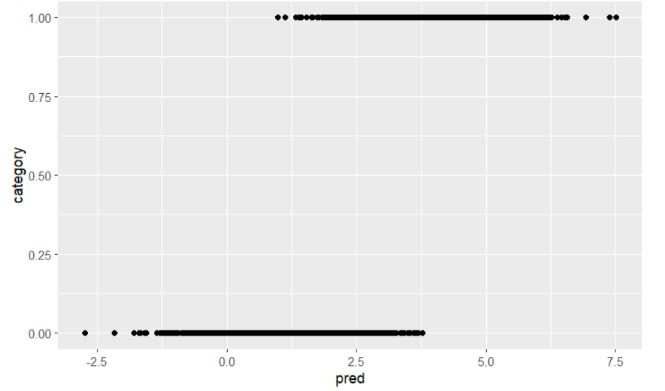
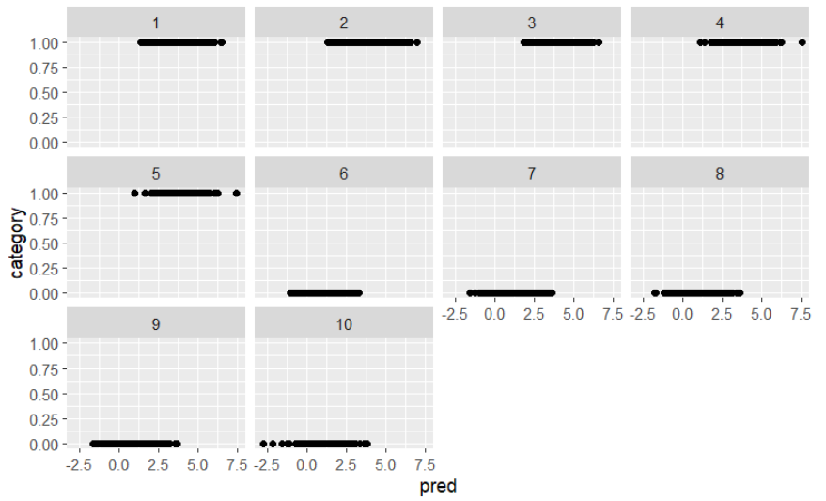
By-Item Random Effects in Logistic Regression: Perfect Predictability
Logistic regression model without by-item intercept: significant difference in predictor between categories
Logistic regression model with by-item intercept: no significant difference in predictor between categories

Slide 37
Challenge: acoustic correlate methodology
Point measurements
Trajectories
Vowel duration (ms) (Charles-Luce 1985; Port & Crawford 1989; Warner et al. 2004)
Voice onset time (ms) (Roettger et al. 2014
Closure duration (ms) (Charles-Luce 1985; Roettger et al. 2014)
Formants at vowel center (Hz) (Fox & Jacewicz 2009)
F0 minima and maxima (Hz) (Yuan & Chen 2014)
Vowel formant contours (Stanley et al. 2021, Hualde et al. 2021)
Liquid formant contours (Simonet et al. 2008)
F0 contours (Chen et al. 2013, Gubian et al. 2015)

Slide 39
F0 Normalization and Centering
Data-processing approaches: why?
By-speaker normalization
Abstract away from speaker pitch range (e.g., Male vs. Female)
Comparing f0 with range of all span categories and items from that speaker
By-token normalization?
Sag theory: equations based on differences in terms of token's F0 range (Pierrehumbert 1981)

Slide 40
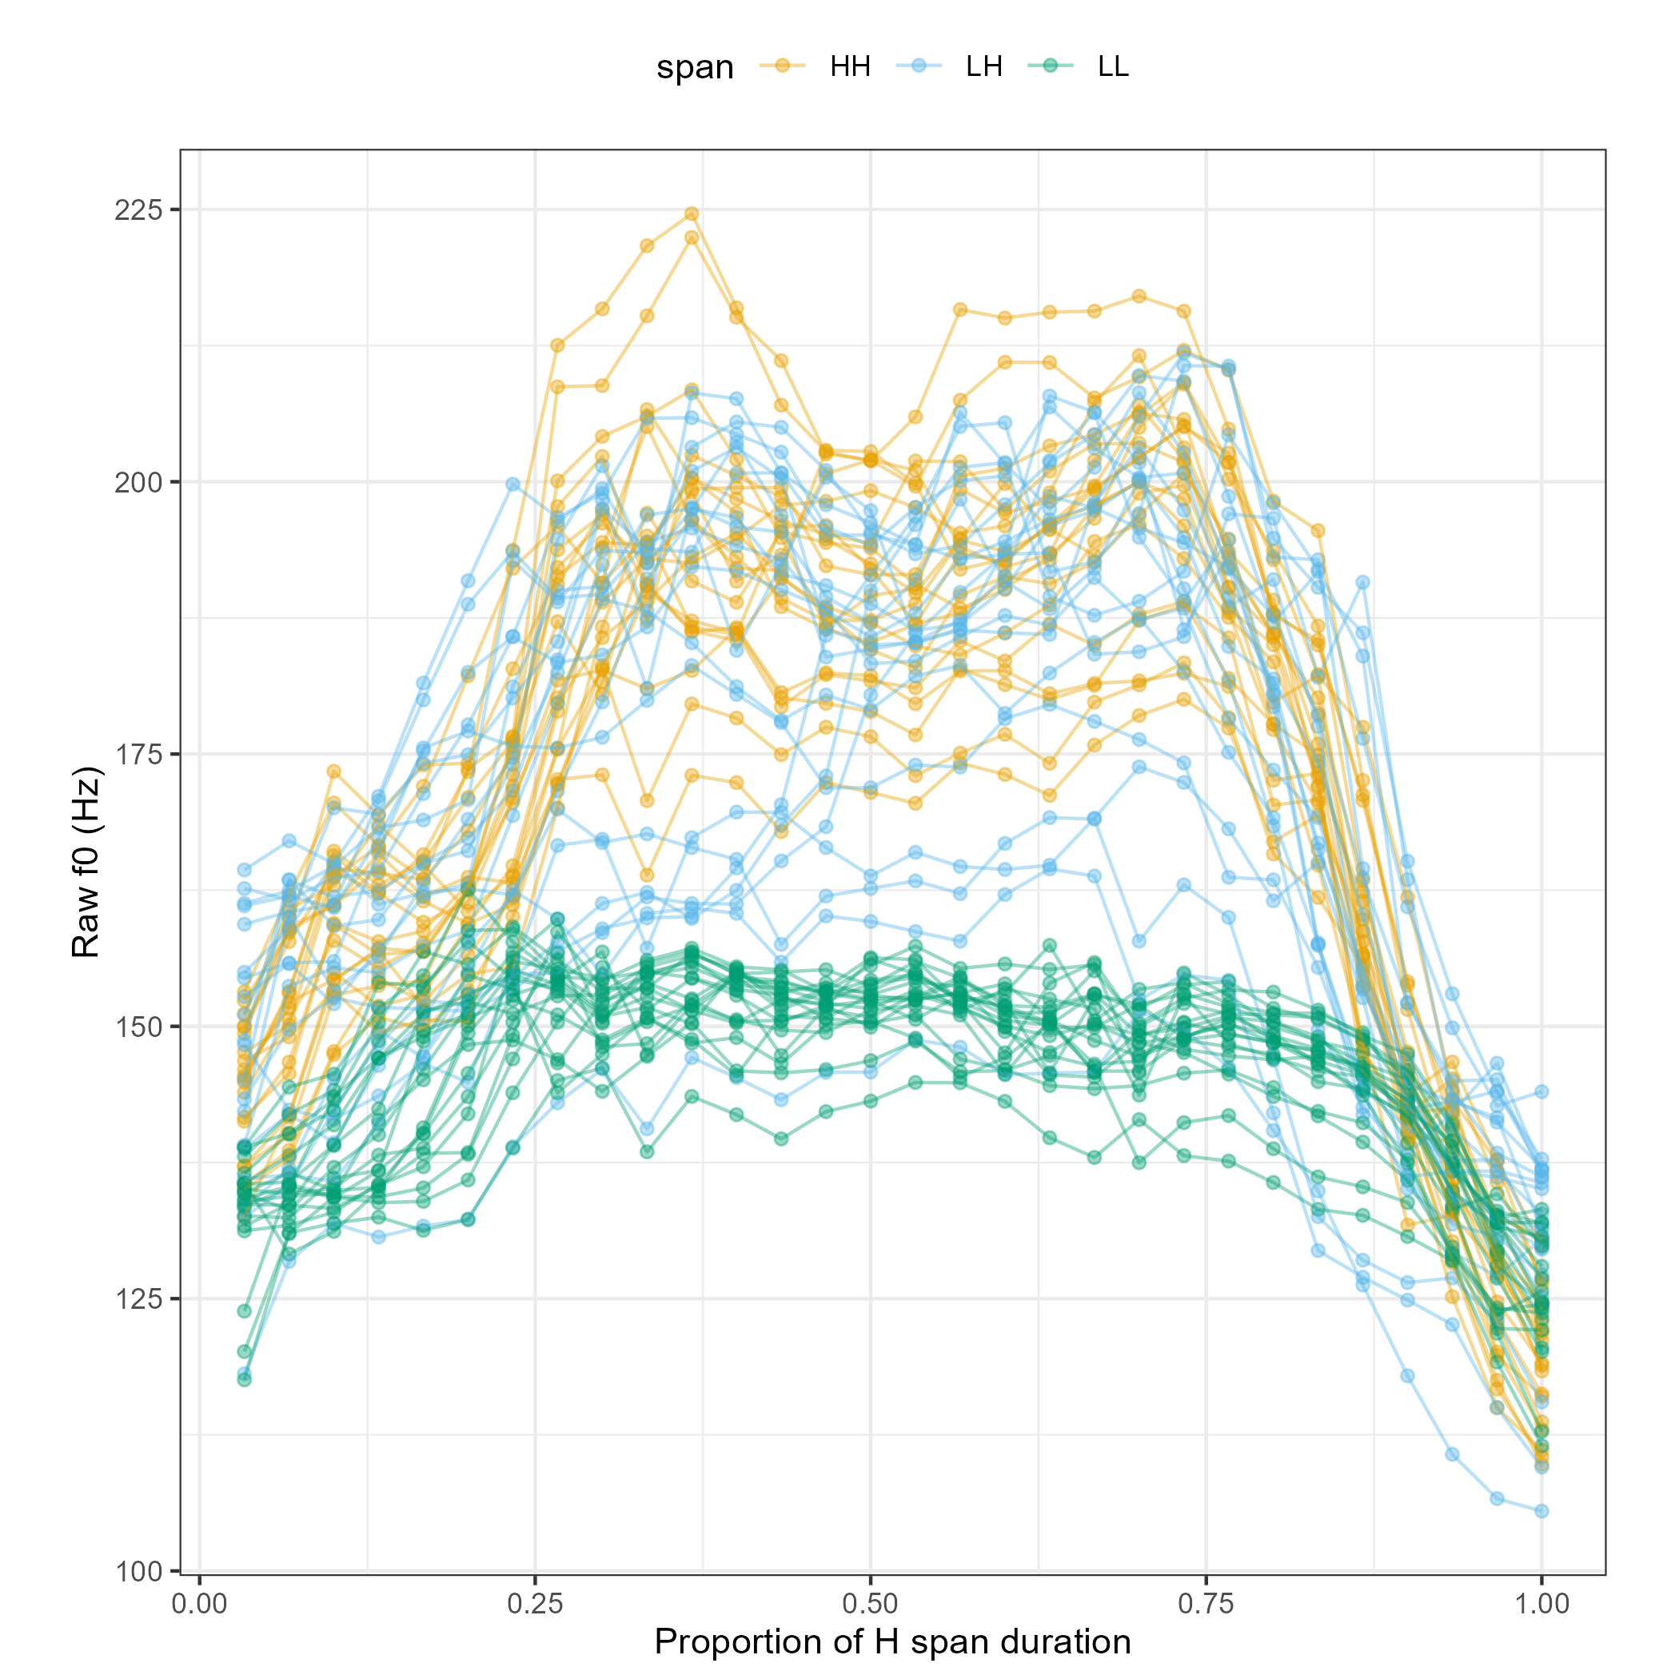
By-Speaker Z-Score Inputs
Speaker 10
Comparing F0 with range of all span categories and items from that speaker

Slide 41
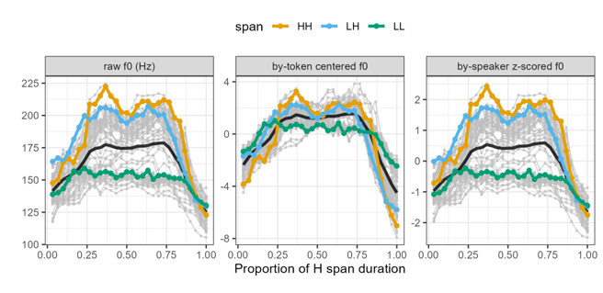

Slide 42
Functional Principal Components Analysis (FPCA)
Mixed effects linear regression model:
Predict sag PC weight from span type (LH or HH)
By-speaker random intercepts
Do LH and HH f0 contours have significantly different sag PC weights?
Sag PC difference between LH and HH
By-speaker f0 normalization: Marginal sag PC difference
By-token f0 centering: Significant sag PC difference
Diagnostics show non-normality: heavy-tailed distribution

Slide 43
By-Speaker Z-Score vs By-Token Centering: Fixed Scale
FPCA: significant difference between sag PC weights for LH and HH
FPCA: marginal difference between sag PC weights for LH and HH
Size of difference interacts with duration

Slide 44
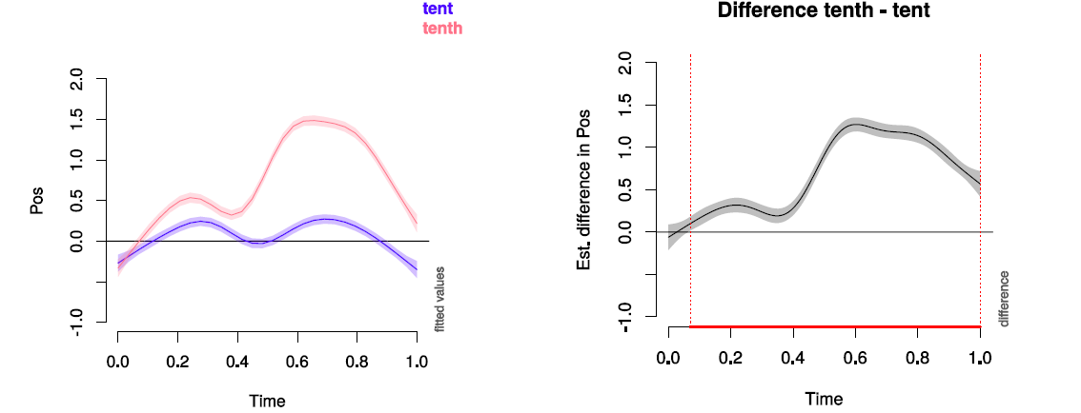
Generalized Additive Mixed-Effects Model (GAMM)
Like FPCA, can build flexible shape to describe trajectory data
Unlike FPCA, takes category membership into account in optimization
Unlike FPCA, no explicit component shapes (no PCs)
Can be defined to model differences in trajectories
Wieling (2018)

Slide 45
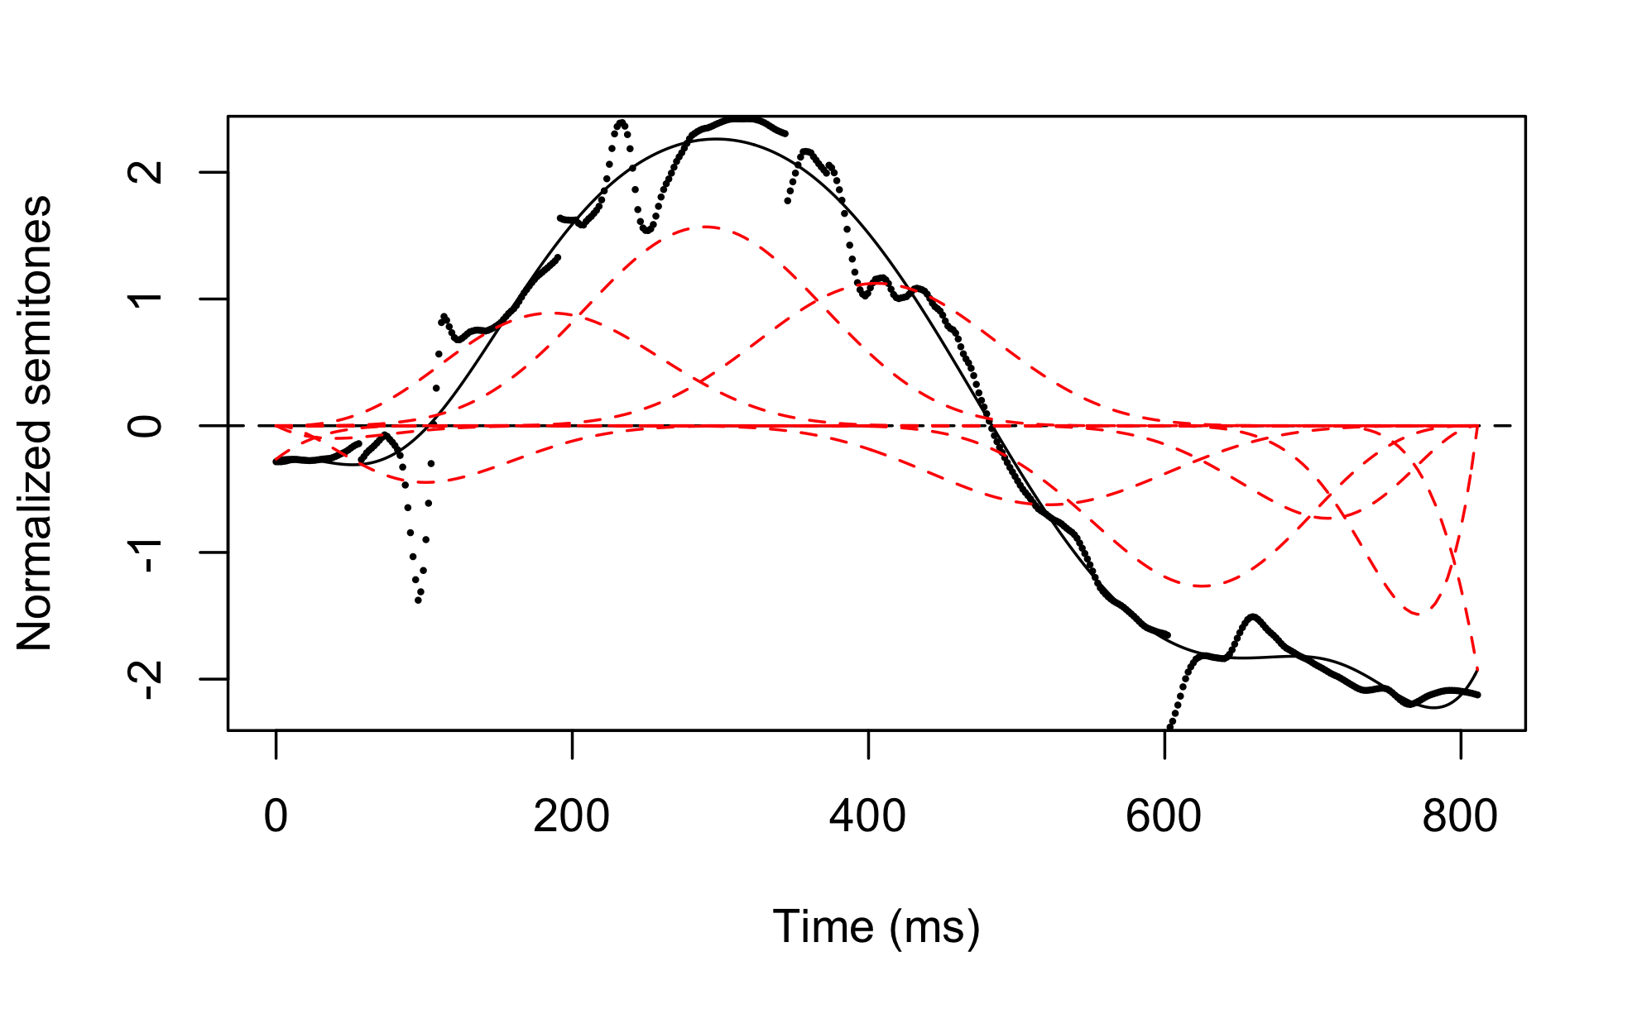
Methods
F0 extracted using VoiceSauce (Shue et al. 2011) with STRAIGHT algorithm (Kawahara et al. 1998)
Analyzed from rise onset to offset as marked in Myers et al. (2018)
Functional data analysis in R using fda package (Ramsay et al .2021)
b-spline basis functions for F0 contour smoothing and parameterization
Mixed effects regressions with span type as dependent variable and principal components (PCs) as fixed effects (and vice versa)

Slide 46
FPCA Findings
Mixed effects logistic regression model: predict LH, HH from PCs
By-speaker random intercepts
By-item random intercepts
 | By-speaker | By-item | By-speaker and by-item
By-speaker normalization | Sag PC difference | No PC difference | No PC difference
By-token centering | Sag PC difference | No PC difference | No convergence

Slide 47
FPCA Findings
Mixed effects linear regression model: predict sag PC weight from span type (LH or HH)
Diagnostics show non-normality: heavy-tailed distribution
 | By-speaker | By-item | By-speaker and by-item
By-speaker normalization |  |  | Marginal sag difference
By-token centering | Sag difference | Sag difference | No convergence

Slide 48
